Slide 1
Causes of the Civil War
Sectionalism
Slavery
State’s Rights
Election of 1860
Lincoln’s name does not appear on the ballot in 10 Southern states.
Secession

Slide 2
The Civil War Begins
Southern states are unhappy with the election.
Do not feel represented.
Dec. 20, 1860 – South Carolina secedes from the United States.
Feb. 1861 – Alabama, Florida, Georgia, Louisiana, Mississippi, & Texas secede.
Deep South – Cotton Kingdom
Lincoln is not in office yet, Buchanan is a “lame duck.”

Slide 3
Lincoln is inaugurated.
Secession is Unconstitutional.
Main goal is to preserve the Union; at any cost.
Did not want to abolish slavery.
Seceded states form the Confederate States of America.
Elect Jefferson Davis as President.
Begin seizing US forts, Post Offices, and other government buildings.

Slide 4
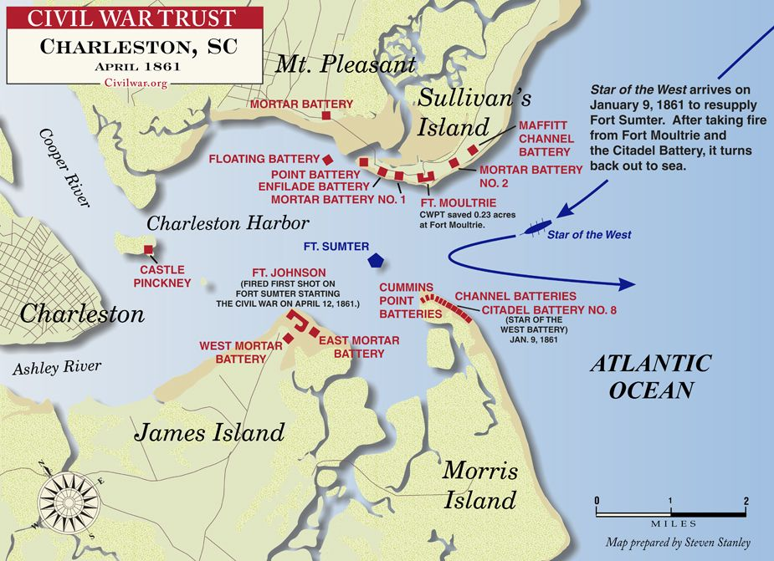

Slide 5
Fort Sumter
Sits in the mouth of harbor – Charleston, S.C.
Important port for the Confederacy
Commander refuses to surrender.
April 12th, 1861, Confederates attack Fort Sumter.
Spark of the Civil War.
Lincoln creates an army to fight the Confederacy.

Slide 6
