Slide 1

Big Business
Second industrial revolution - dominance of big business in the United States
Its growth became questionable by citizens and the government
  Led to the formation of monopolies

Slide 2
Big Business
Consolidation
Monopoly
    Horizontal Integration
    Trust
Vertical Integration
Social Darwinism

Slide 3
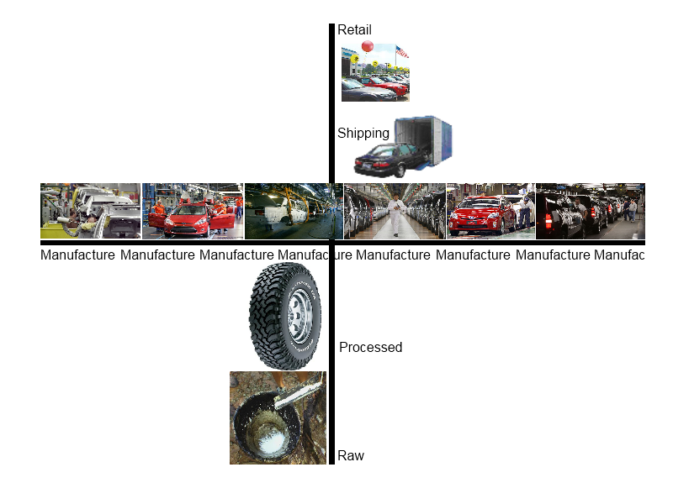

Slide 4
Corporations
Publicly owned companies
    shares of stock
limited liability
able to raise money or capital from sale of stock
    can become very large and powerful because of this

Slide 5
Robber Barons
Term used to describe industrialist of the late 1800’s
Robber - referring to criminal or immoral behavior
Baron – referring to the illegitimate claim to power of medieval lords of the manor.
    Anti-American

Slide 6

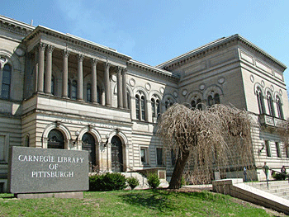
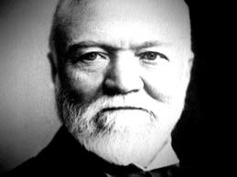
Carnegie
Self-made man, poor Scottish immigrant
    Upward mobility
Used Bessemer process and vertical integration to dominate the steel industry
Philanthropist

Slide 7
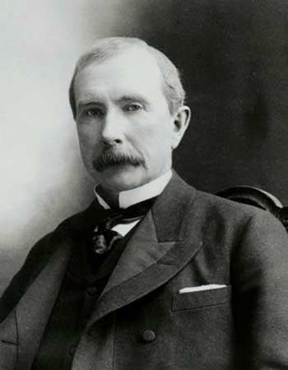
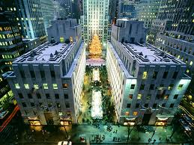
Rockefeller
Oil refineries
Slashed prices and consolidated
Creates Standard Oil Trust
Owns/controls 95% of oil refineries in the country.

Slide 8
Benefits of Competition
LOW PRICES
HIGH QUALITY
NEW INNOVATIONS

Slide 9
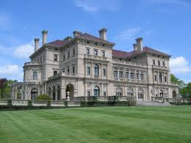
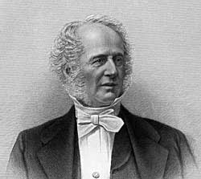
Vanderbilt
Steamships and then railroads
Used consolidation to drive competitors out of business
Ruthless tactics, manipulating suppliers against competition
Created a monopoly

Slide 10
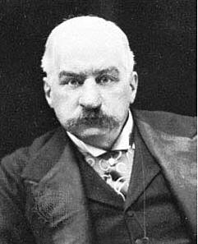

Morgan
Transformed the banking industry
Used banks money to buy, consolidate, and invest in corporations.
          Not just savings and loan
Massive consolidation and manipulation

Slide 11
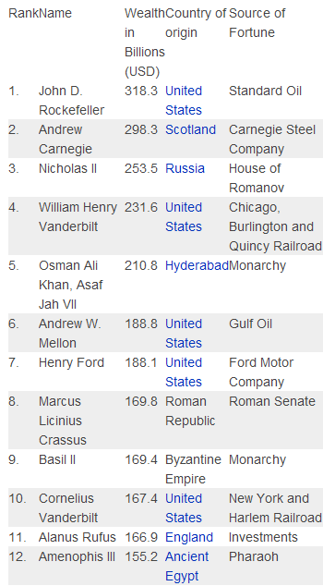
Wealthiest people in the World

Slide 12
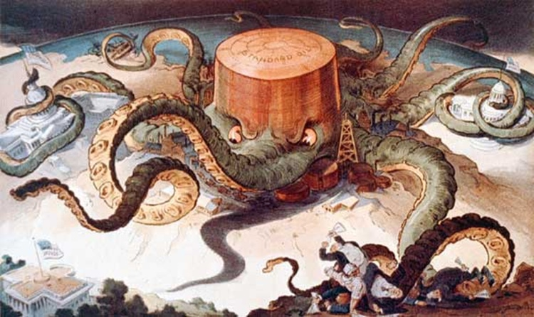

Slide 13


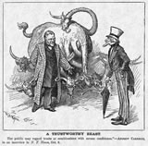
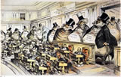

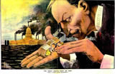
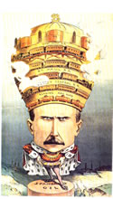

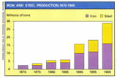
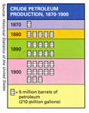


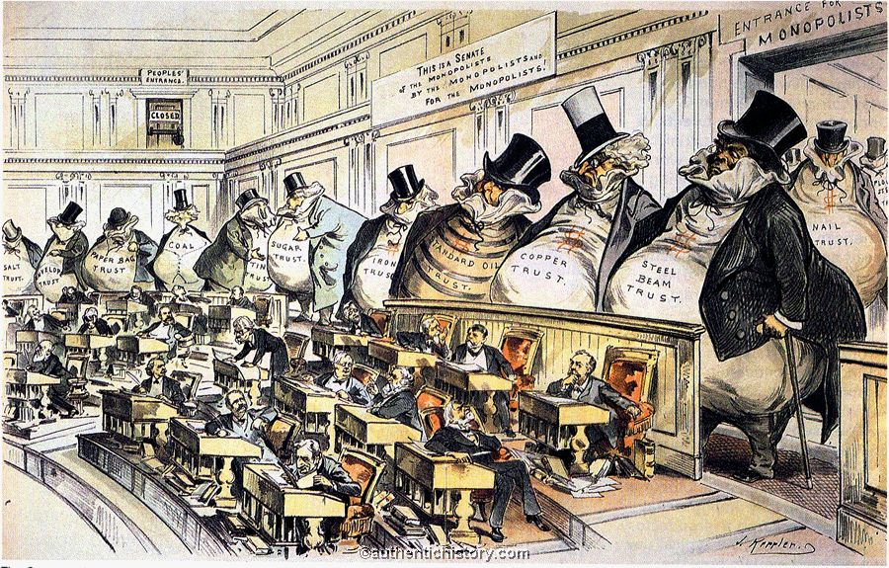
home > 1898-1913 > industrialization > becoming an industrial society
Search for:
Becoming an Industrial Society
Becoming an Industrial Society
A more detailed examination of this topic is planned for the future. In the meantime, this small collection of images is presented.
The Growing Influence of Robber Barons, Monopolies, & Trusts
Cornelius Vanderbilt as the modern Colossus of railroads, Puck magazine, 1879, by Joseph Keppler | "A Trustworthy Beast," Harper's Weekly, October 20, 1888, by William A. Rogers | "Bosses of the Senate," Puck, January 23, 1889, by Joseph Keppler | Populism Cartoon: The West and South feed the country while Wall Street milks it, c.1890 | "What a Funny Little Government," The Verdict, August 25, 1899, by Herbert Taylor
John D. Rockefeller, of Standard Oil, as Emperor. Puck magazine, 1901, Artist unknown
Statistics
Railroads, 1870-1900 | Iron & Steel Production, 1870-1900 | Crude Petroleum Production, 1870-1900
Industrial Imagery
1900s Stereoview, "Marvelous Type-Setting Machines, Sears" (2 views) | 1900s Stereoview, "Watchmaking at Sears Roebuck" (2 views)
| top |
Last modified July 17, 2011 © 1999-2011, The Authentic History Center
"Bosses of the Senate," Puck, January 23, 1889, by Joseph Keppler

Slide 14

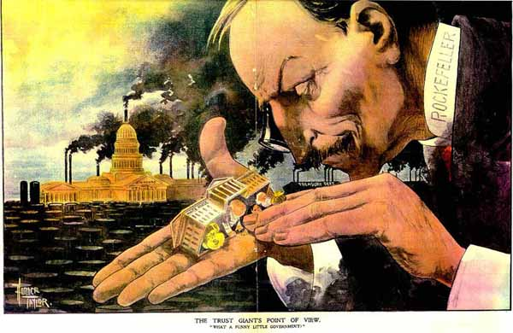
home > 1898-1913 > industrialization > becoming an industrial society
Search for:
Becoming an Industrial Society
Becoming an Industrial Society
A more detailed examination of this topic is planned for the future. In the meantime, this small collection of images is presented.
The Growing Influence of Robber Barons, Monopolies, & Trusts
Cornelius Vanderbilt as the modern Colossus of railroads, Puck magazine, 1879, by Joseph Keppler | "A Trustworthy Beast," Harper's Weekly, October 20, 1888, by William A. Rogers | "Bosses of the Senate," Puck, January 23, 1889, by Joseph Keppler | Populism Cartoon: The West and South feed the country while Wall Street milks it, c.1890 | "What a Funny Little Government," The Verdict, August 25, 1899, by Herbert Taylor
John D. Rockefeller, of Standard Oil, as Emperor. Puck magazine, 1901, Artist unknown
Statistics
Railroads, 1870-1900 | Iron & Steel Production, 1870-1900 | Crude Petroleum Production, 1870-1900
Industrial Imagery
1900s Stereoview, "Marvelous Type-Setting Machines, Sears" (2 views) | 1900s Stereoview, "Watchmaking at Sears Roebuck" (2 views)
| top |
Last modified July 17, 2011 © 1999-2011, The Authentic History Center
"What a Funny Little Government," The Verdict, August 25, 1899, by Herbert Taylor

Slide 15
Sherman Anti-Trust Act
A law passed by Congress to:
  Make monopolies illegal
  Make trusts that restrained trade illegal
  Problem: Trusts - not clearly defined
    Couldn’t enforce

