Slide 2
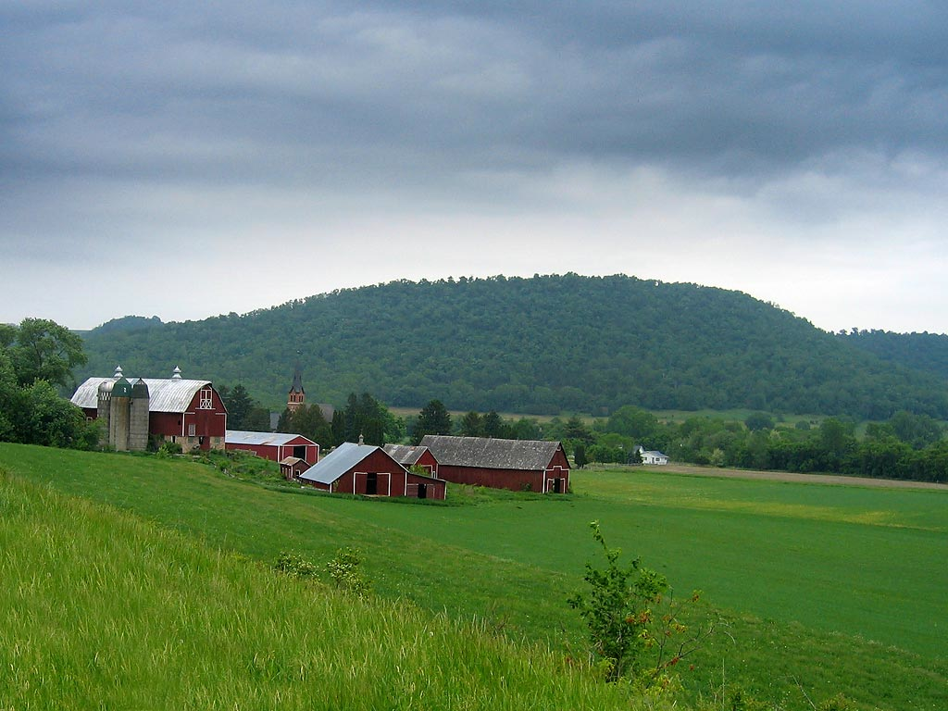
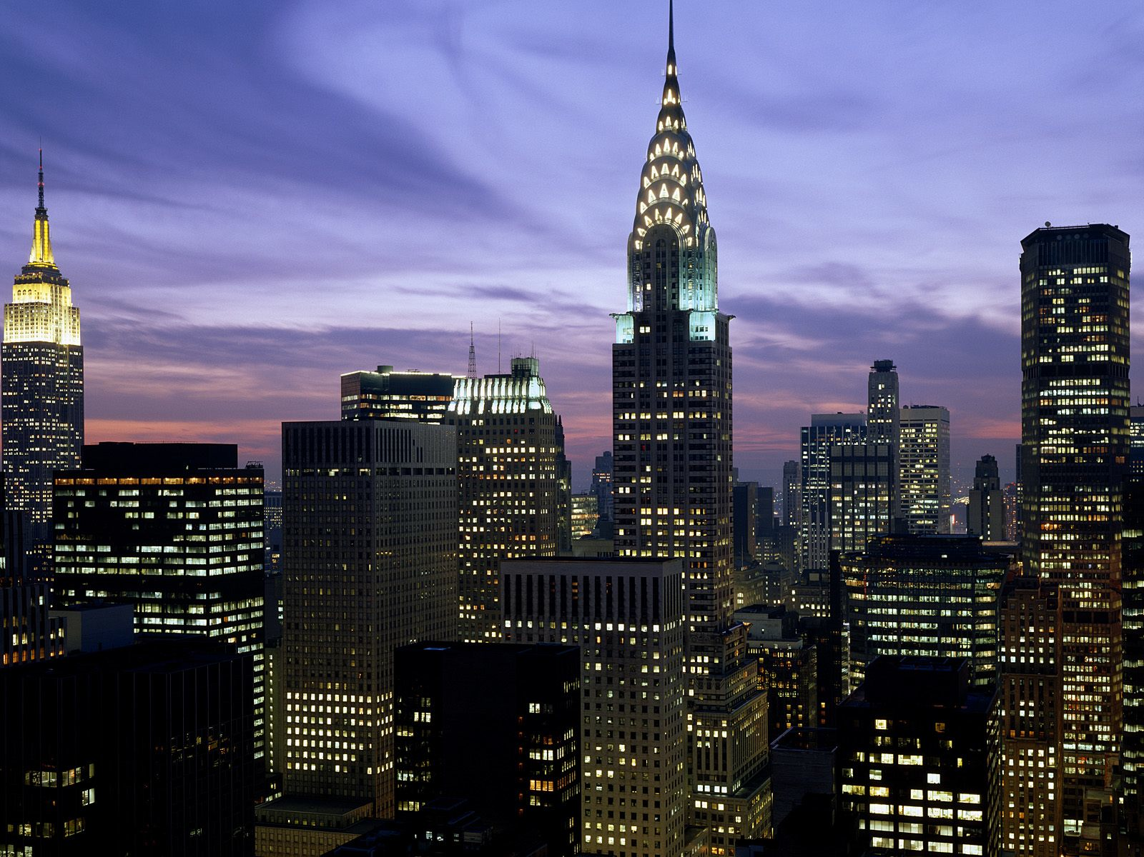
Urbanization
The movement of people from rural to urban areas

Slide 7
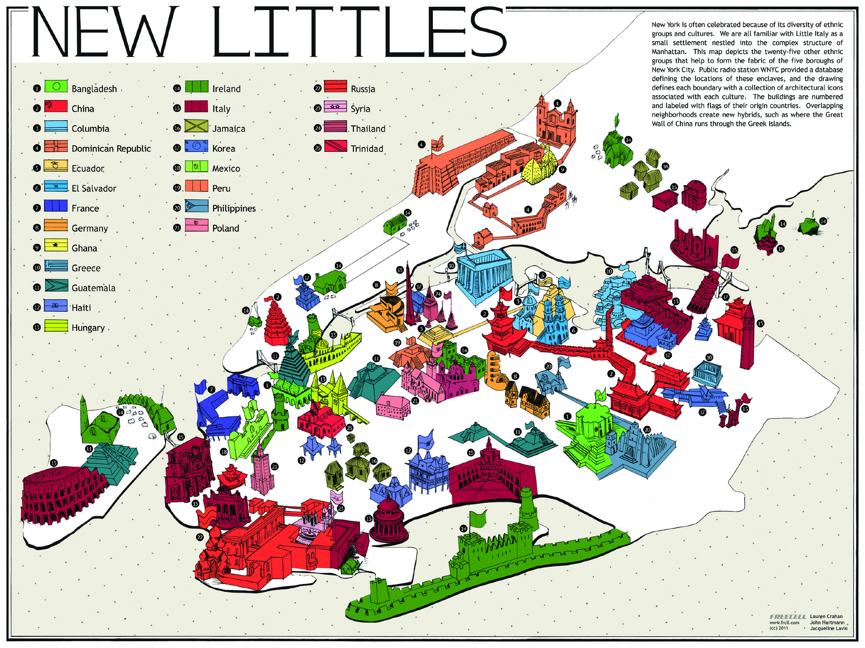

Slide 8
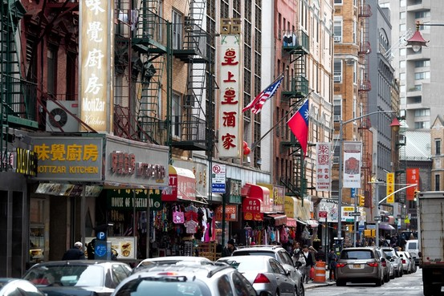
Ethnic Neighborhoods

Slide 9
Benefits of Urbanization
Technological advancement
Cultural opportunity
Community improvement
…But what were some of the negative parts of urban life?

Slide 10
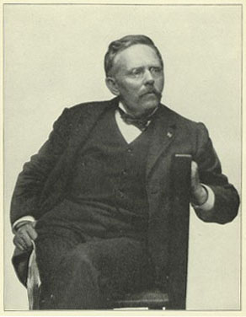
Jacob Riis
Reformers dedicated their lives to improving conditions in cities.
Muckraking journalist
Exposed horrible tenement conditions in How the Other Half Lives

Slide 11
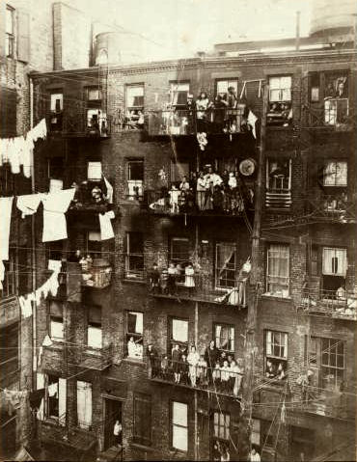

Slide 12
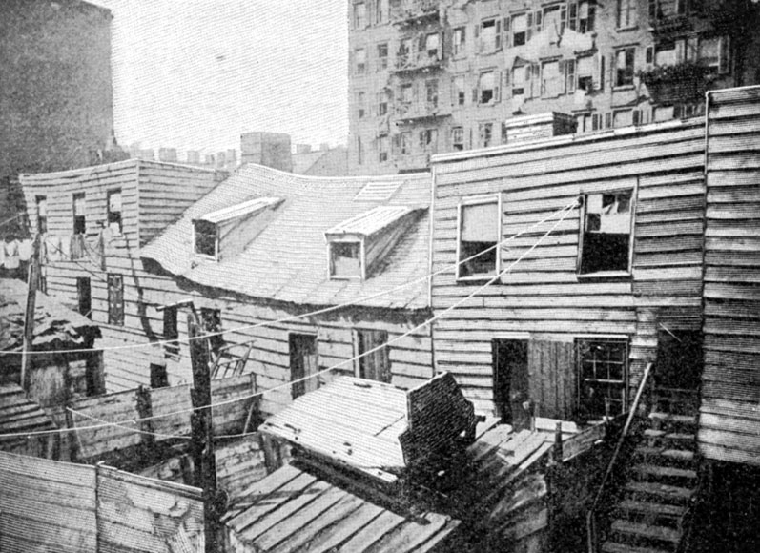
Slums

Slide 13
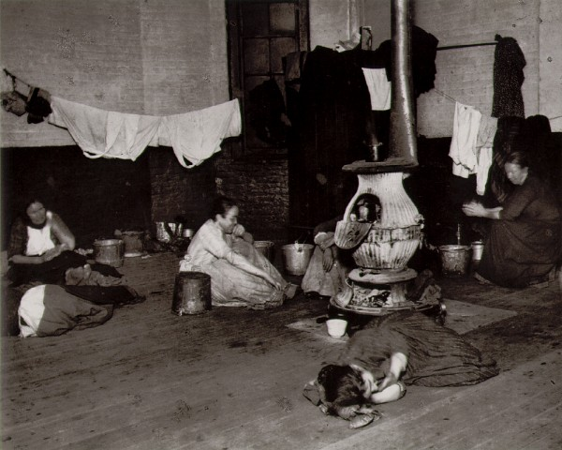

Slide 14
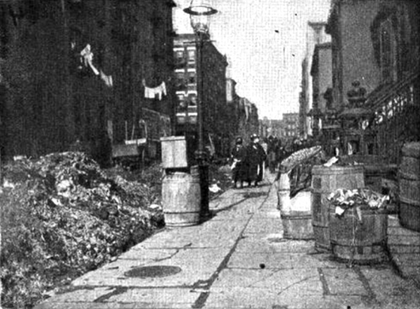

Slide 15
Effects of Reformers
1893 – Illinois passes labor laws
Limit womn’s working hours
Prevent child labor
1901 - New York State Tenement House Act
Called for ventilation, running water
A model for housing reform in other cities

Slide 16
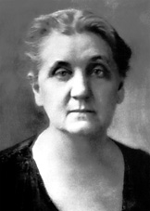
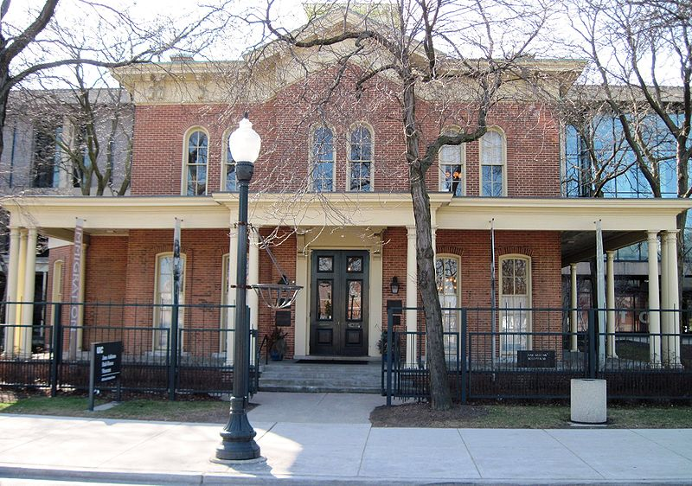
Jane Addams & The Hull House
Famous Settlement House in Chicago
Offered education, recreation, social activities
Kindergarten, cooking, sewing & art classes, plays, sports

Slide 17
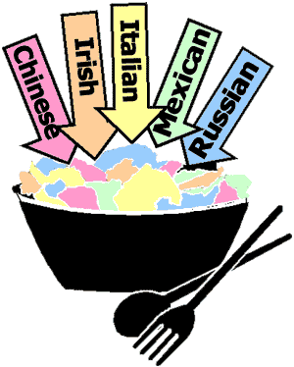
Considering everything we’ve learned about immigration and urbanization, what makes the United States a melting pot? What makes it a salad bowl? Be specific.

